Slide 1
MMME4054 Week 2 - Human Information Processing & Memory
Dr Kyle Harrington

Slide 2
Lesson Plan
Recap
Good/Bad Design
Human Information Processing
Modal Model
Working Memory
Other issues with memory
Break
Quiz
Coursework Setting
Practical

Slide 3
Recap 1/2
What did you learn last week?

Slide 4
Recap 2/2
Module intro
The origins of Ergonomics
Traditional vs. contemporary view of ergonomics
The onion model
Human Factors in Boeing 737Max MCAS
Examples of good and bad ergonomics in design

Slide 5
Learning objectives
Module LO’s:
LO1 –Describe how humans process information and how this applies in a variety of working contexts.
LO3 –Critically analyse a variety of products and systems according to the extent that they support human behaviour and performance.
LO4 –Analyse data related to cognitive performance and interpret it in the context of literature.
LO5 – Recognise the variety of products and work contexts to which cognitive ergonomics design practice and guidance can be applied.
Lecture objectives:
Learn about Human Information Processing
Introduce elements of perception
Understand the different types and characteristics of memory
Consider the above in the context of design

Slide 6
Recommended reading
Wickens, C.D., Helton, W.S., Hollands, J.G. and Banbury, S., 2021. Engineering psychology and human performance. Routledge. – good resource for extra reading on human information processing
Also look at the work of Eysenck (memory), Loftus (eyewitness)
The following are the original references, but likely to find the concepts summarised in psychology/human factors text books:
Atkinson, R.C. and Shiffrin, R.M., 1968. Human memory: A proposed system and its control processes. In Psychology of learning and motivation (Vol. 2, pp. 89-195). Academic Press.
Baddeley, A.D. and Hitch, G., 1974. Working memory. In Psychology of learning and motivation (Vol. 8, pp. 47-89). Academic press.

Slide 7
Student Examples of good/bad cognitive ergonomics
Thank you to everyone who submitted!
Don’t have time to review all submissions – I’ve picked the ones with a high cognitive element.

Slide 8
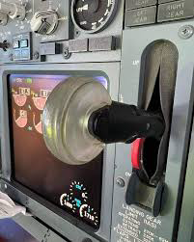
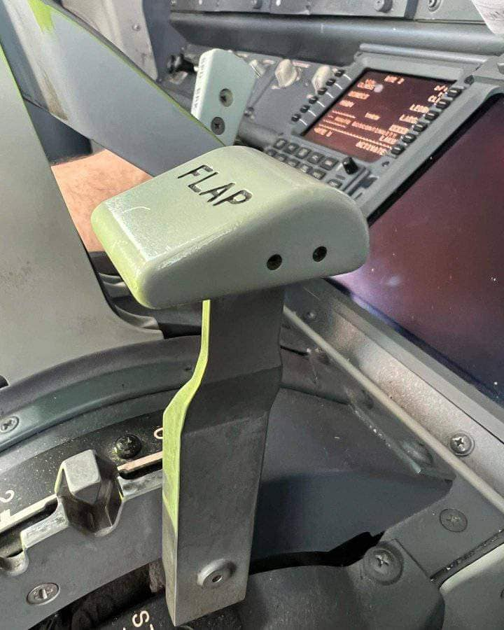
Good design
Helps prevent pilots retracting the wrong handle, which could be detrimental in the take-off sequence. This has happened in previous accidents.
Landing gear retraction lever, shaped like a wheel.
Flap retraction handle. Shaped like a flap

Slide 9

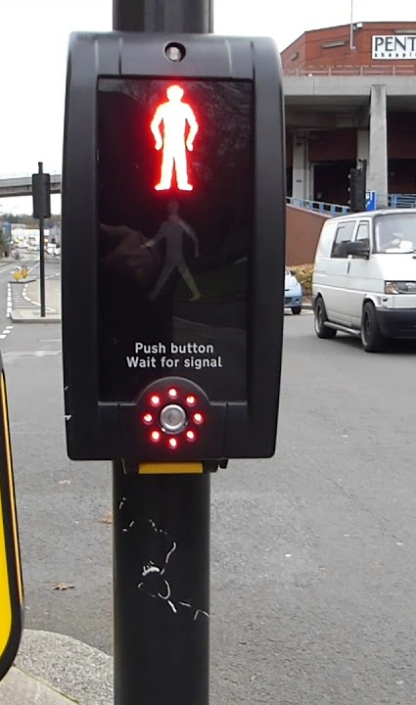
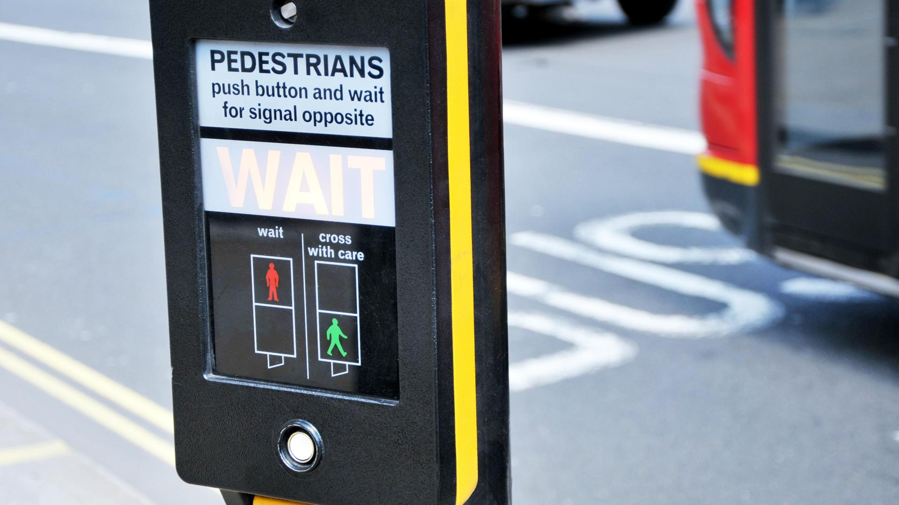
Hi Dr Harrington,
When you showed that video from ‘I think you should leave’ about the door being mistaken as a pull, I instantly thought of this video by Key and Peele about American crosswalk buttons.
The premise being that there is no confirmation indicator that the button has been pressed, rather it being just a metal spring-loaded circle attached to the street furniture that is often thought to give you a positive placebo that the light is going to change and let you cross the road. I put some extra pictures in on the following slides to illustrate further.

Slide 10

Once you start crossing, you get a red hand with a count down timer. The count down timer being red, and continuously a hand sign to stop, are both negative messages toward the pedestrian.
Red hand = don’t walk
Timer = if you are walking, hurry up
Both messages signalling to pedestrians in America that the road prioritises motor vehicles and not pedestrians / cyclists who are not on motorised transport.

Slide 11
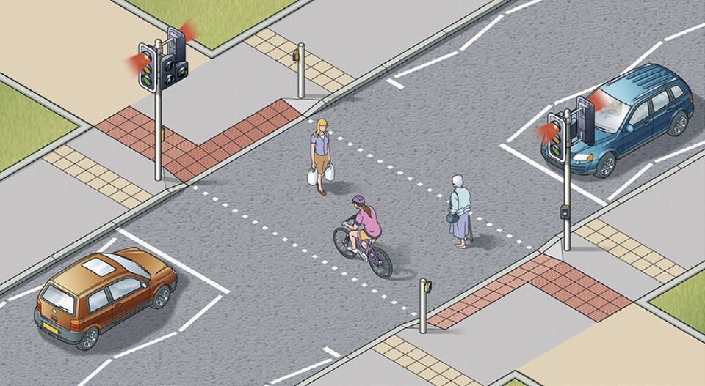
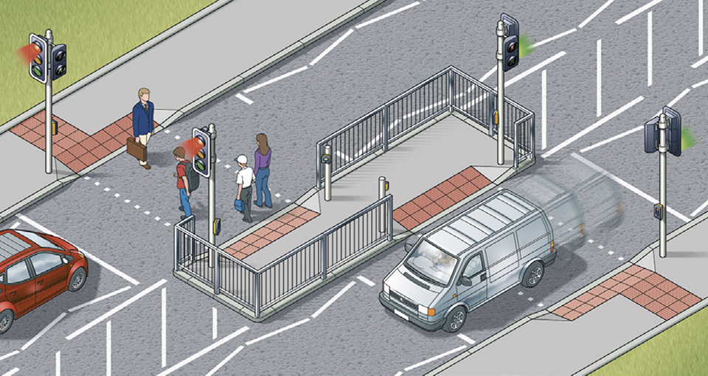
Compared to a good design like in the UK:
Dropped curb for accessibility needs
Tactile markings on the ground for accessibility needs
Zigzag markings approaching the crossing to try and prevent anyone parking and blocking of the line of sight to pedestrians crossing
No timer hurrying the pedestrians
Highway code indicating that any pedestrian still on the road must be given way to until they have finished crossing
There’s a whole lot more to this design, including different types of crossings that get implemented with additional or fewer features depending on the necessity of the design to reduce risk to pedestrians and also increase the flow of traffic (like the image on the right that allows only one side of the road to be stopped at a time and also prevents pedestrians from being able to get across to the other side without making the conscious decision to push another button so they don’t accidentally run out into traffic, very satisfying design with some great poka-yoke)

Slide 12

My shower controls
Very visually confusing
Only clue to differentiate between pressure and temperature is a small red button
Tiny arrows showing which way turns the water hotter or colder, shown in a text which doesn’t stand out
Hard to tell which way to turn the dial to start the water – no text or anywhere that is easy to grip to indicate – especially when wet in the shower
-

Slide 13
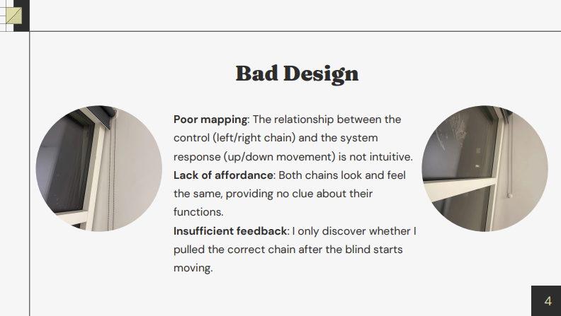

Slide 14
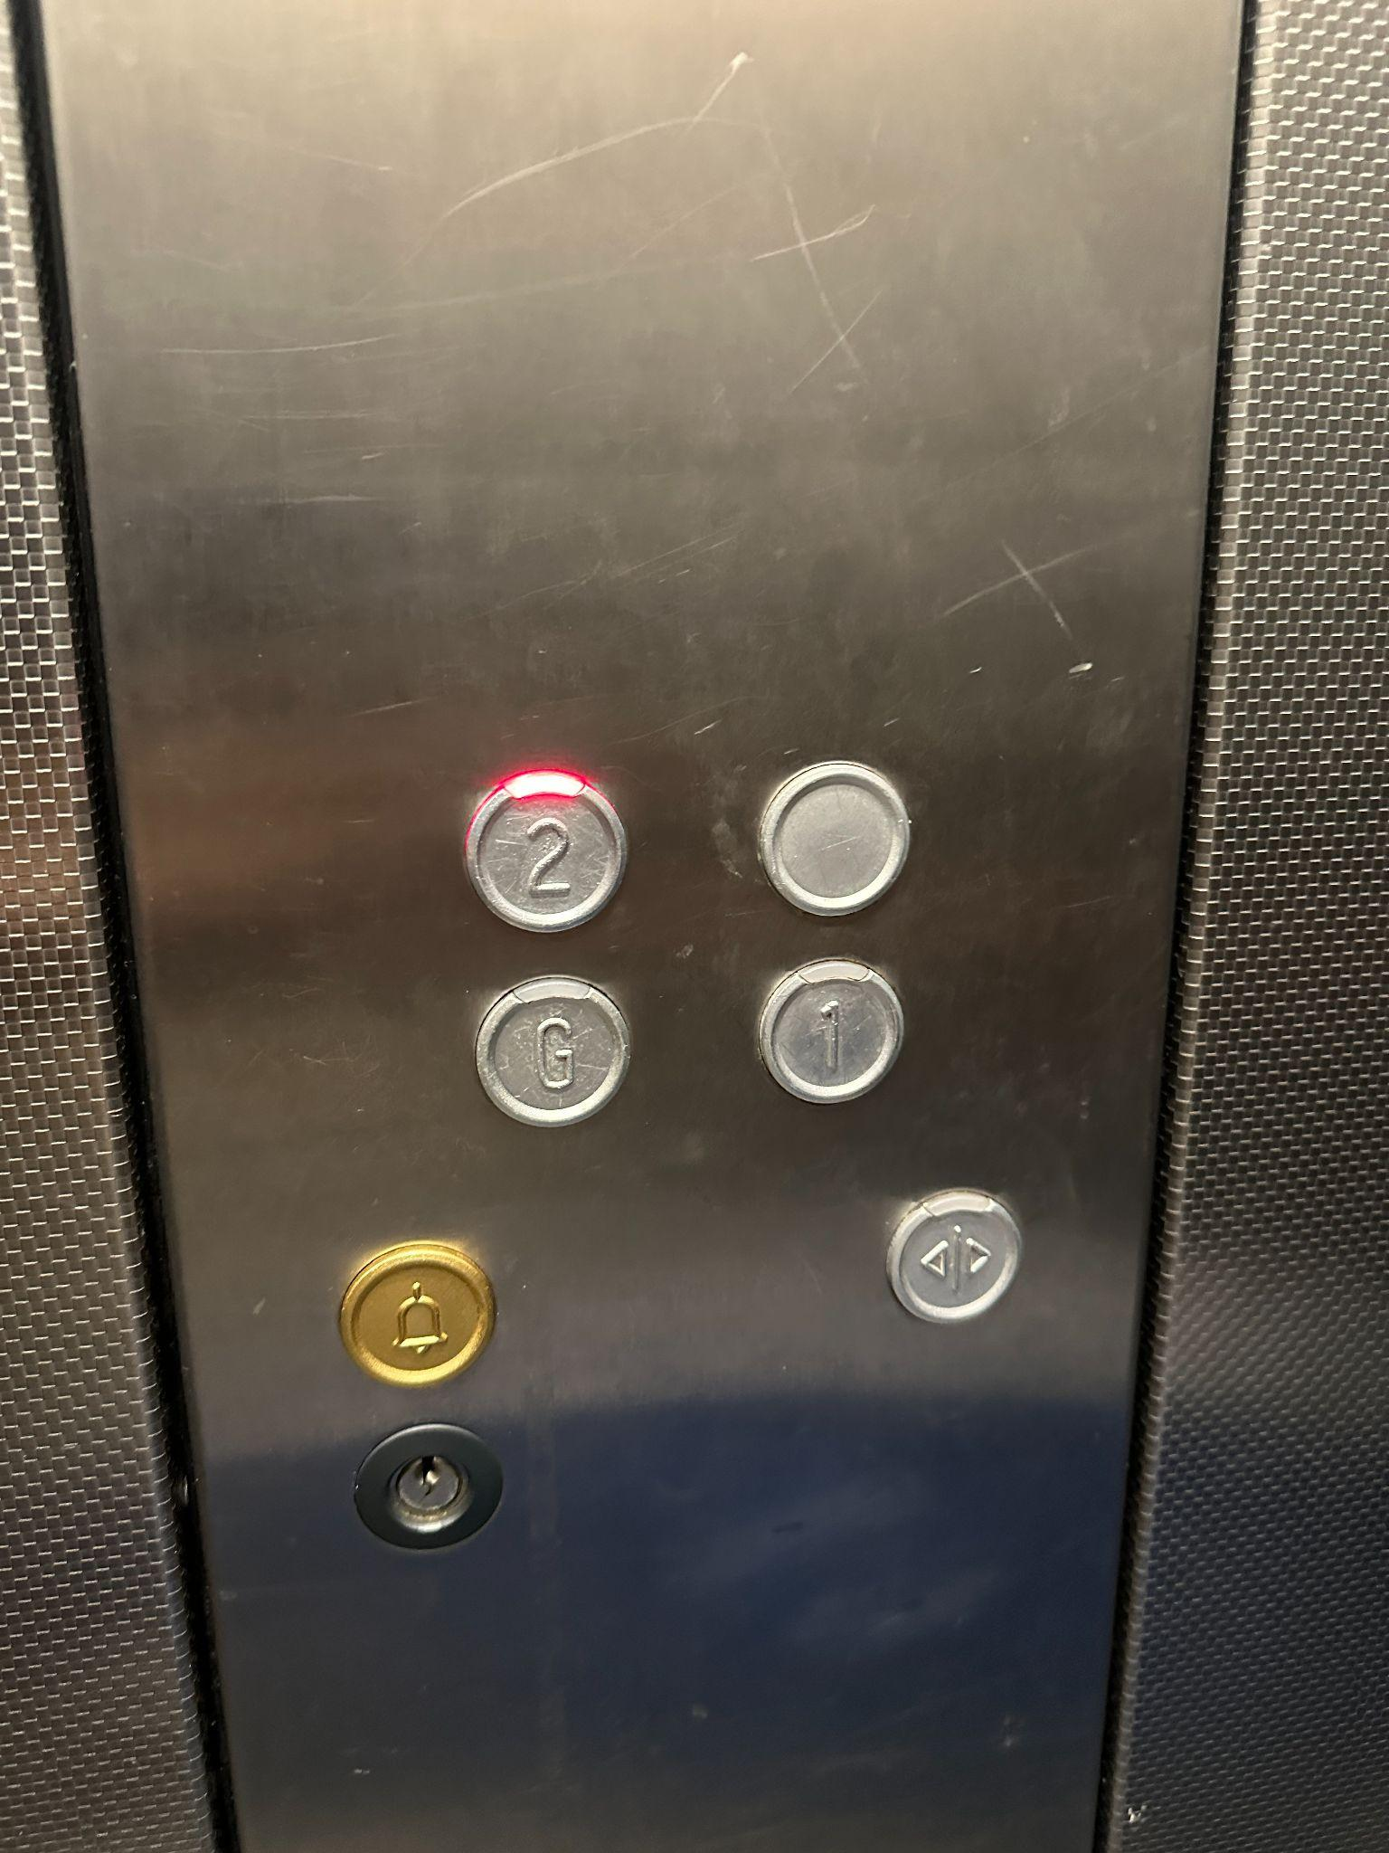
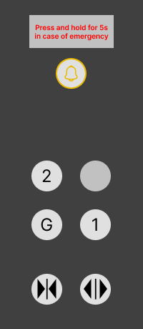
No instructions for emergency
No “close door” button and observed multiple people subconsciously pressing the “open door” button thinking it was the close button
Lift Control Panel
Ideal Control Panel

Slide 15


Which button turns on the light?
Notes:
All 5 buttons look exactly the same, but one of them turns on the light, 3 of them turn on the extractor hood on 3 different levels and one button turns it off.
Left is off
Then the 3 buttons turn it on, the further to the right the stronger
The button all the way to the right turns on the light

Slide 16
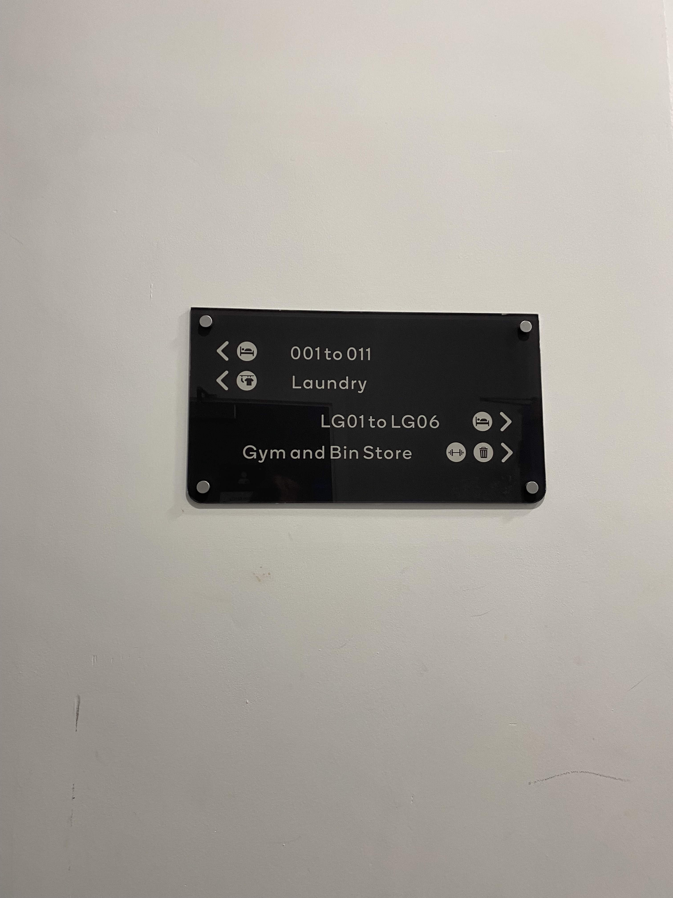
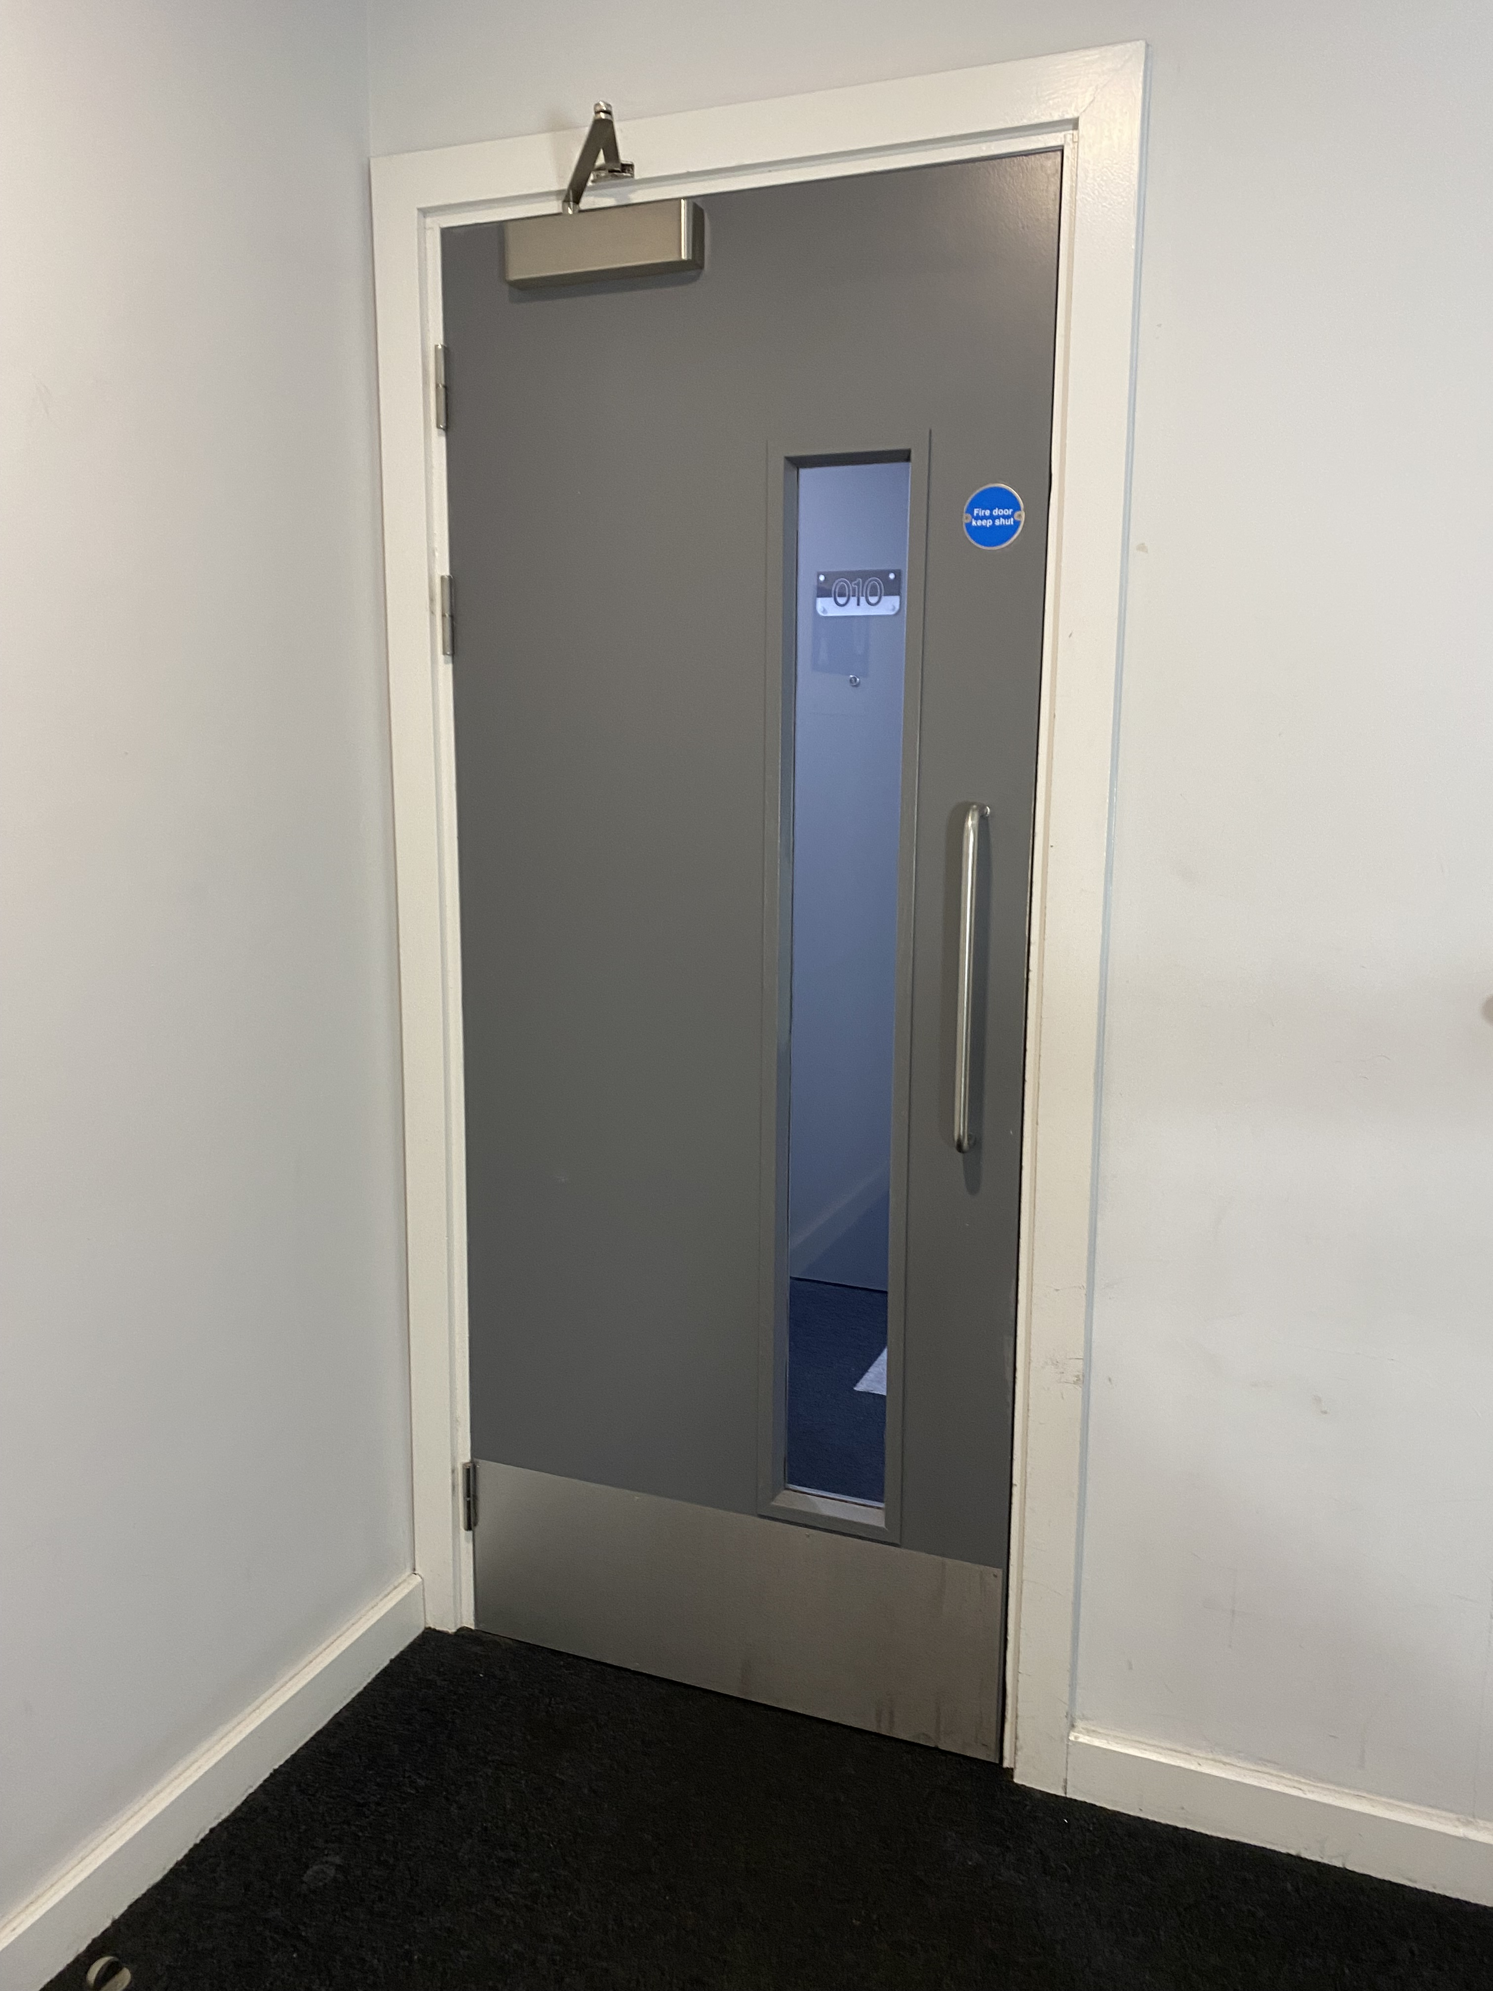
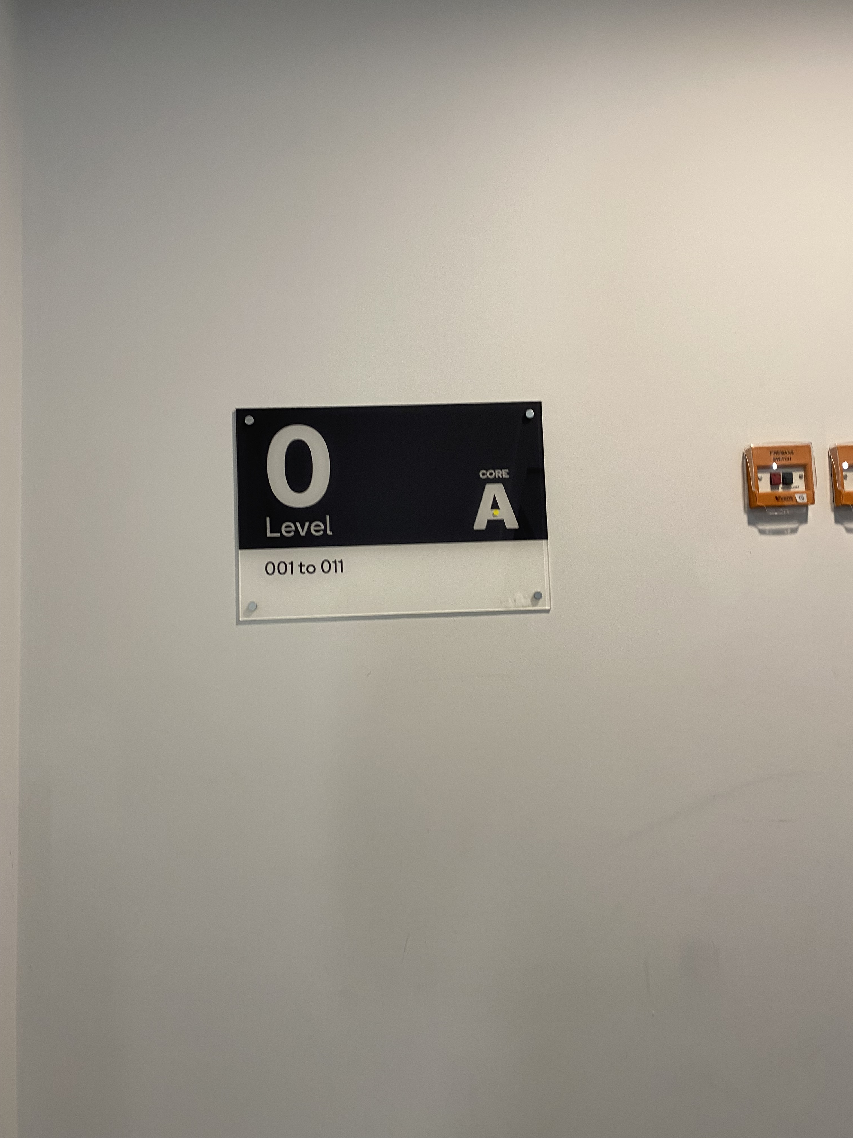
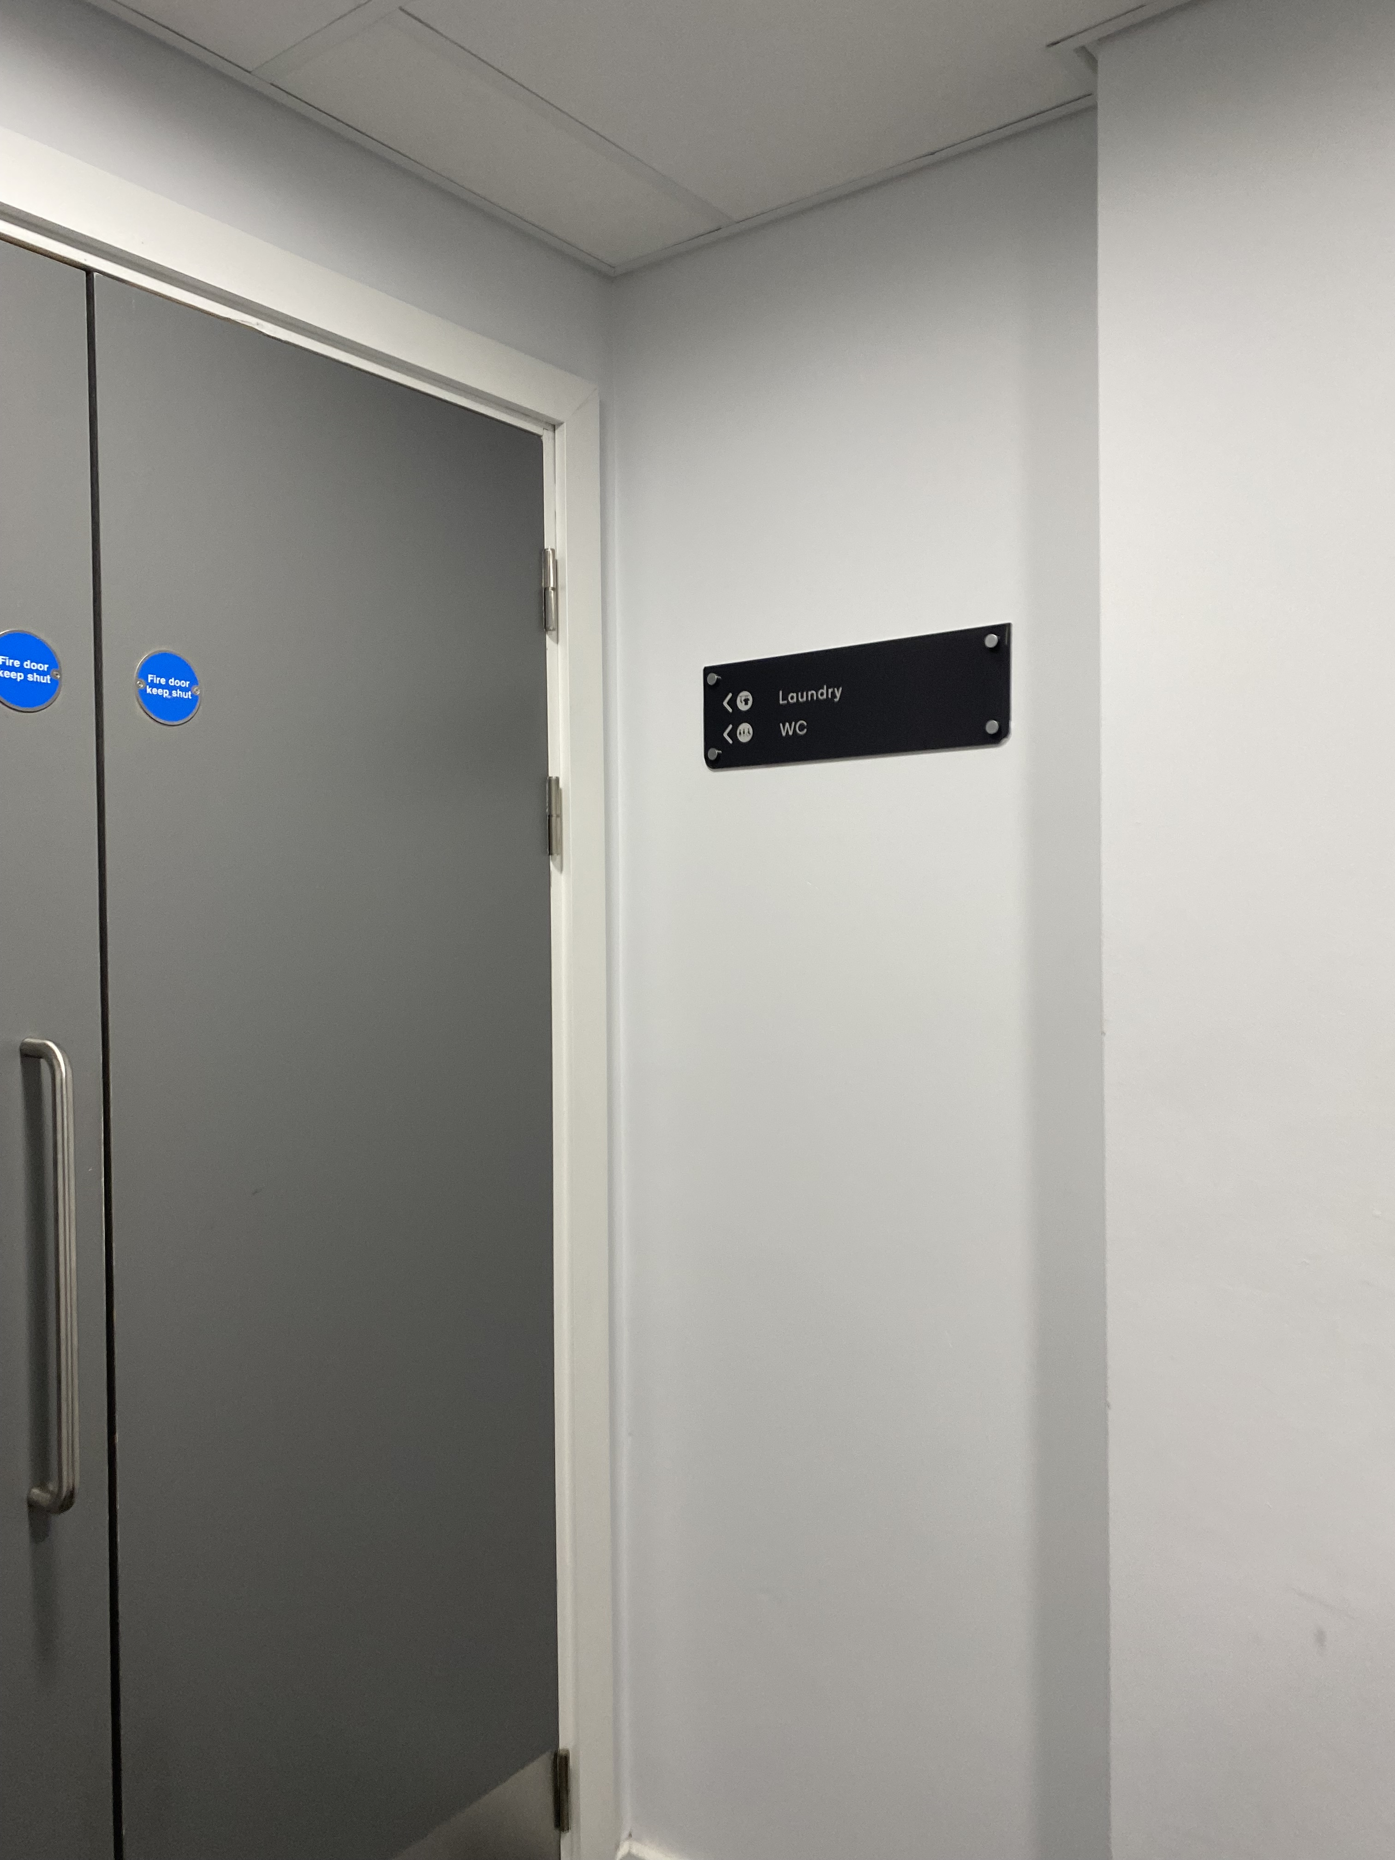
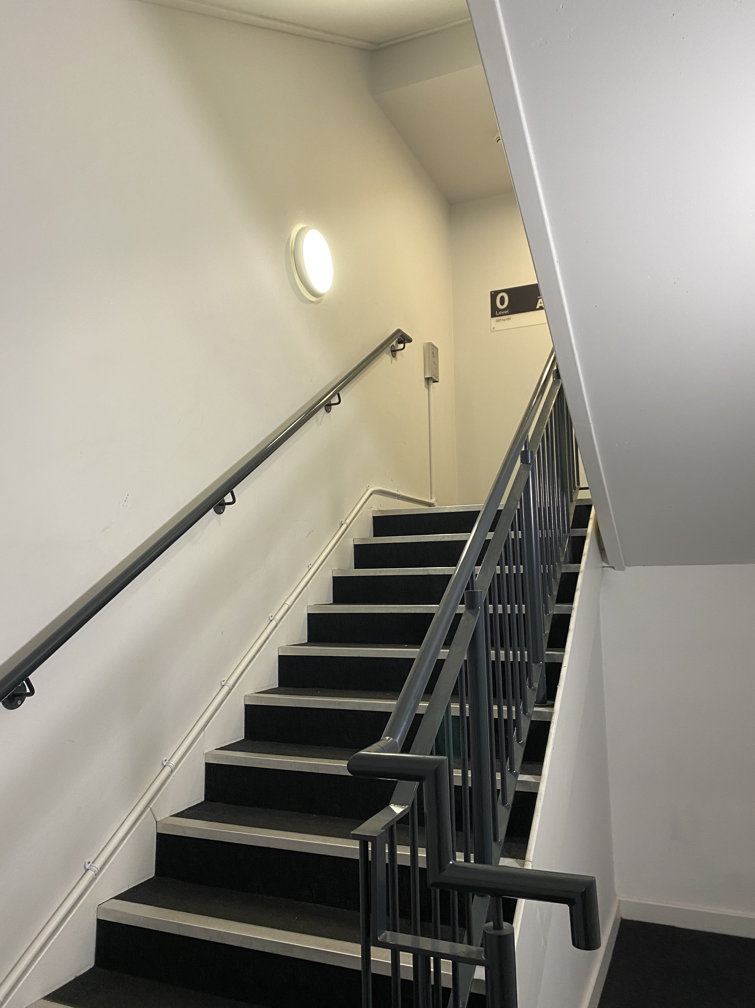
Trying to find the laundry room, just follow the sign through the door to the left…
Assuming it must be on the first floor, there is a corridor going both directions, so you must guess the correct direction
…and then go through two more doors before finally another sign!
…but the door to the left leads to just a staircase
Lots of trial and error to find the laundry room!

Slide 17
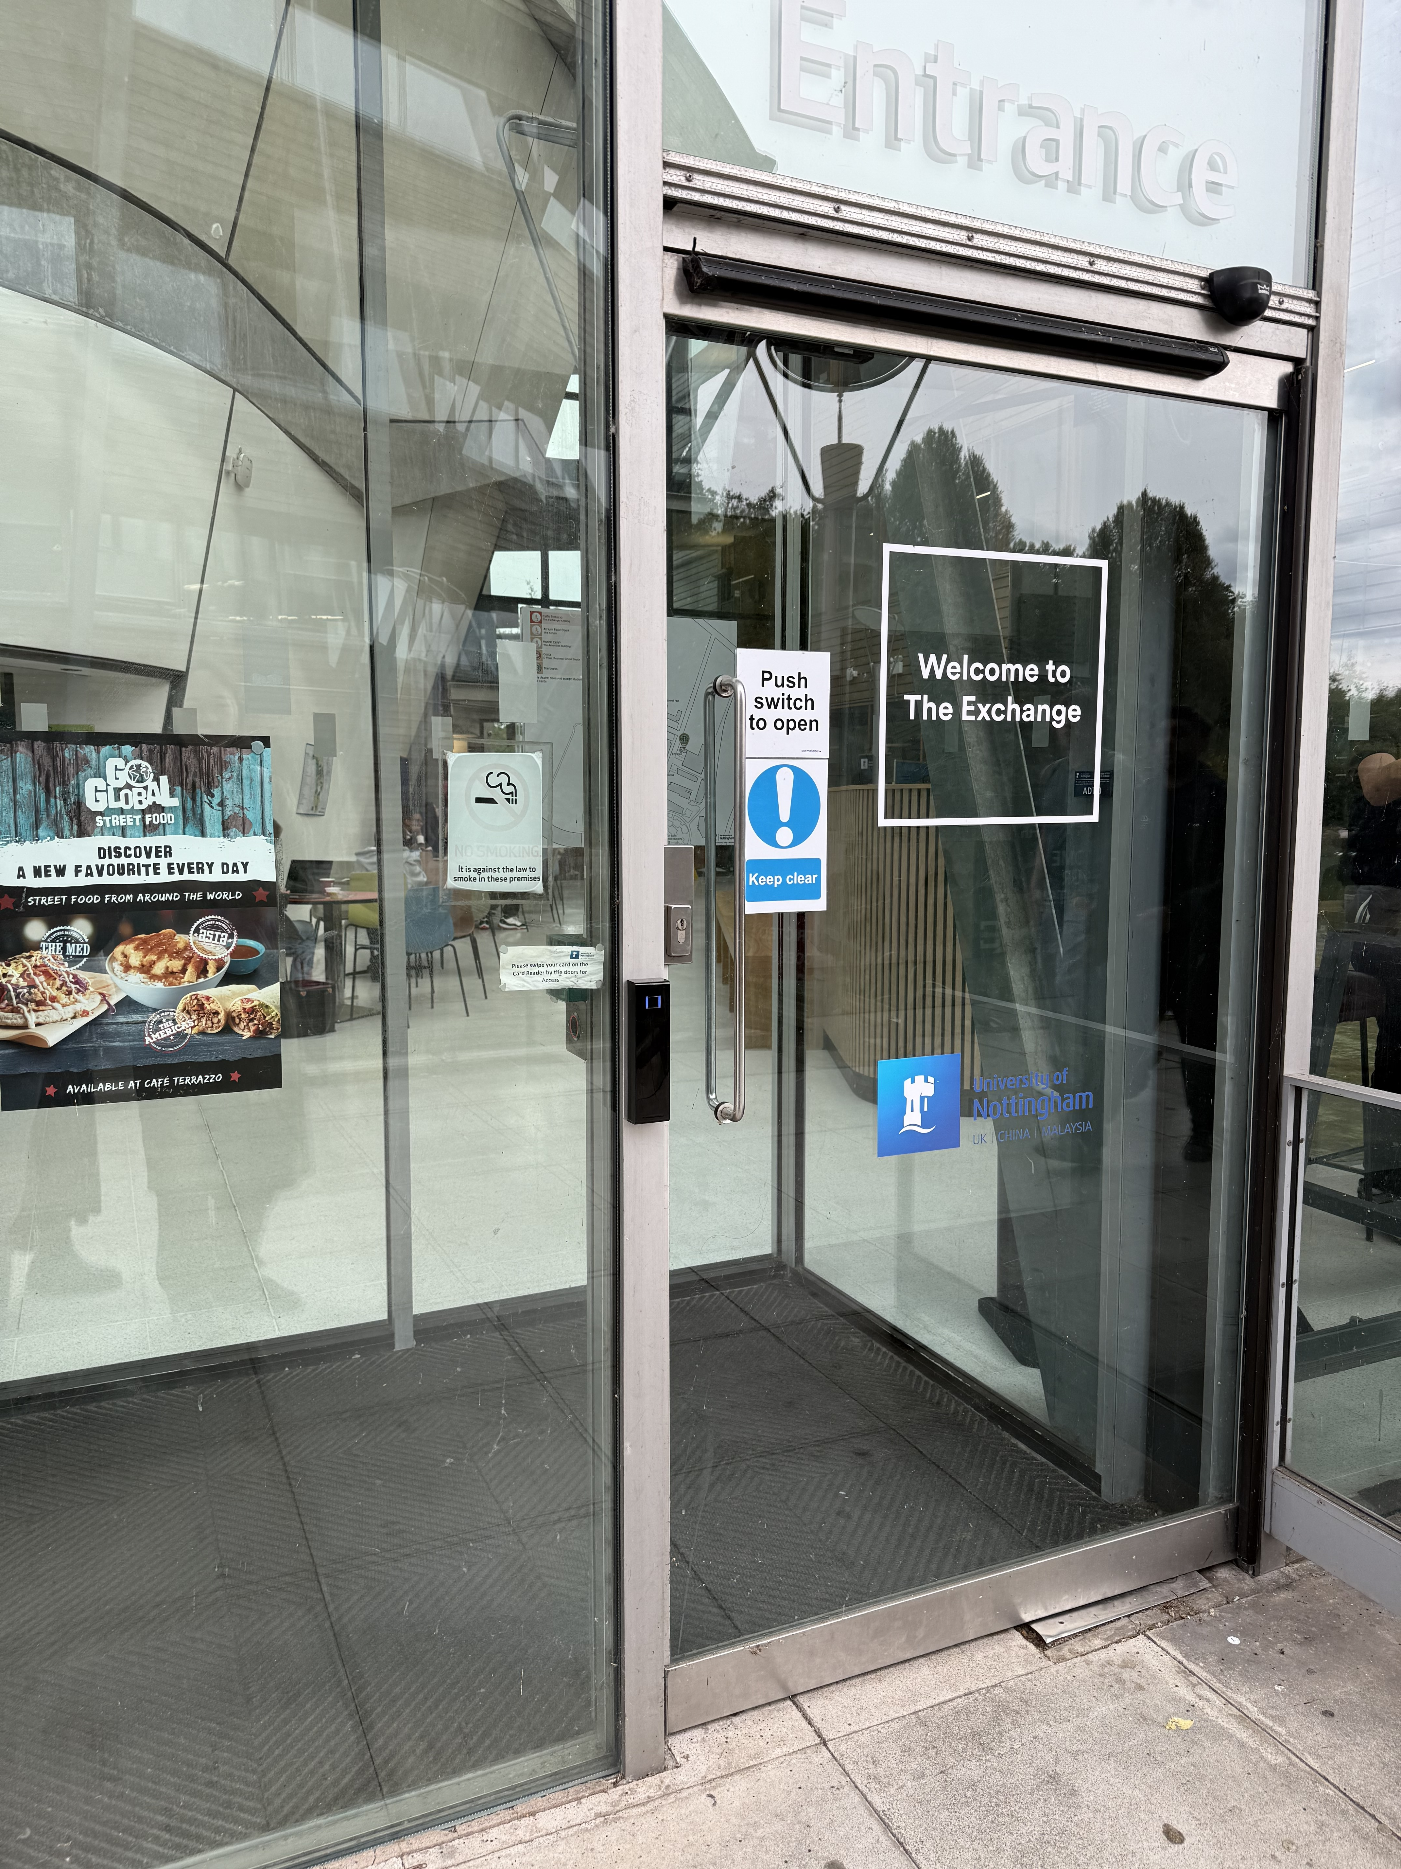
1. There wasn’t a switch immediately near the door
2. You had instead tap your ID card for the door to open
3. It is an automatic door so the handle wasn’t much of a use

Slide 18
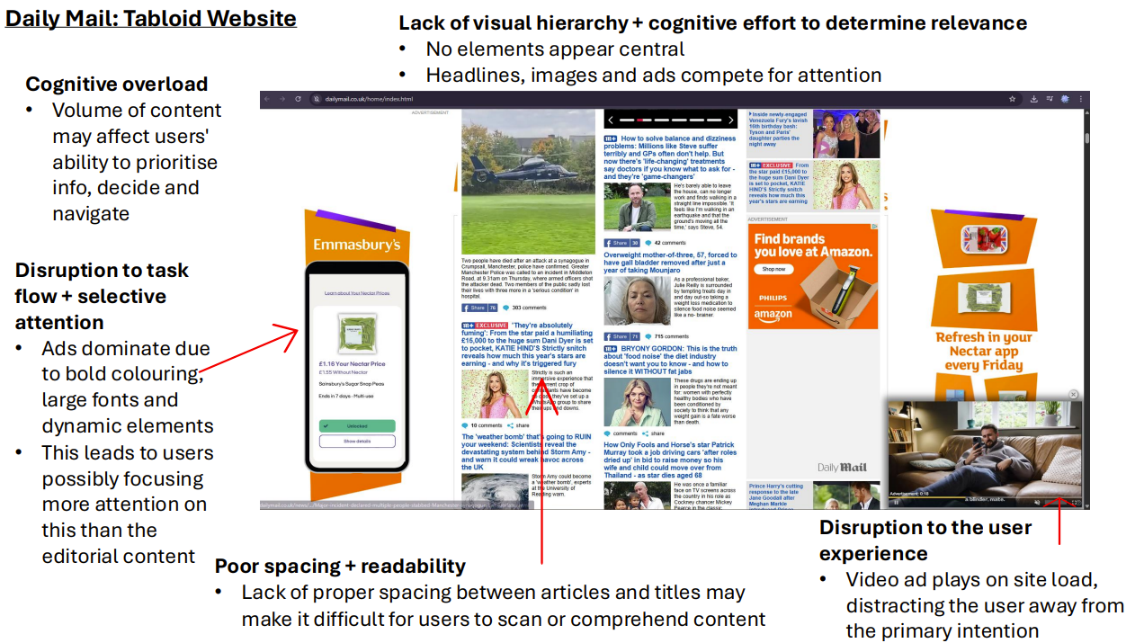

Slide 19

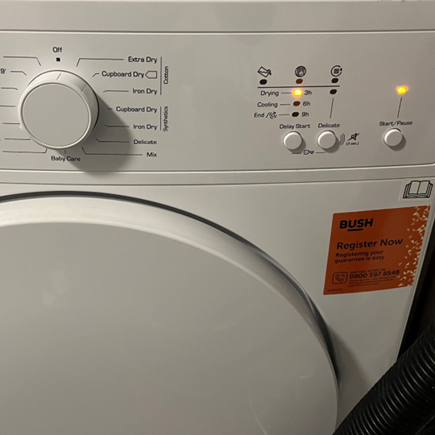
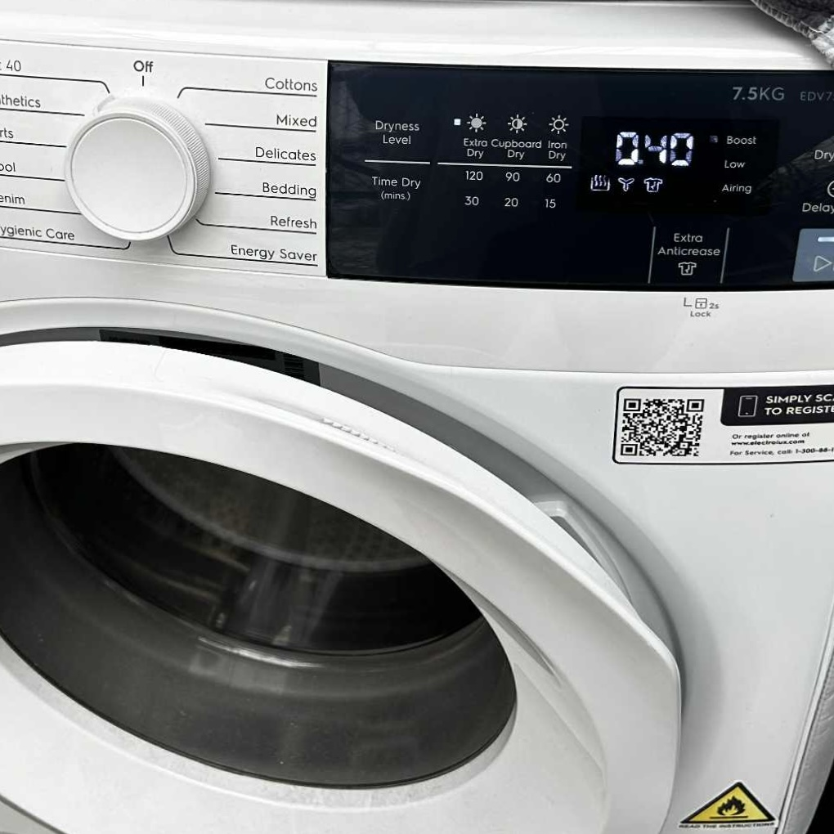
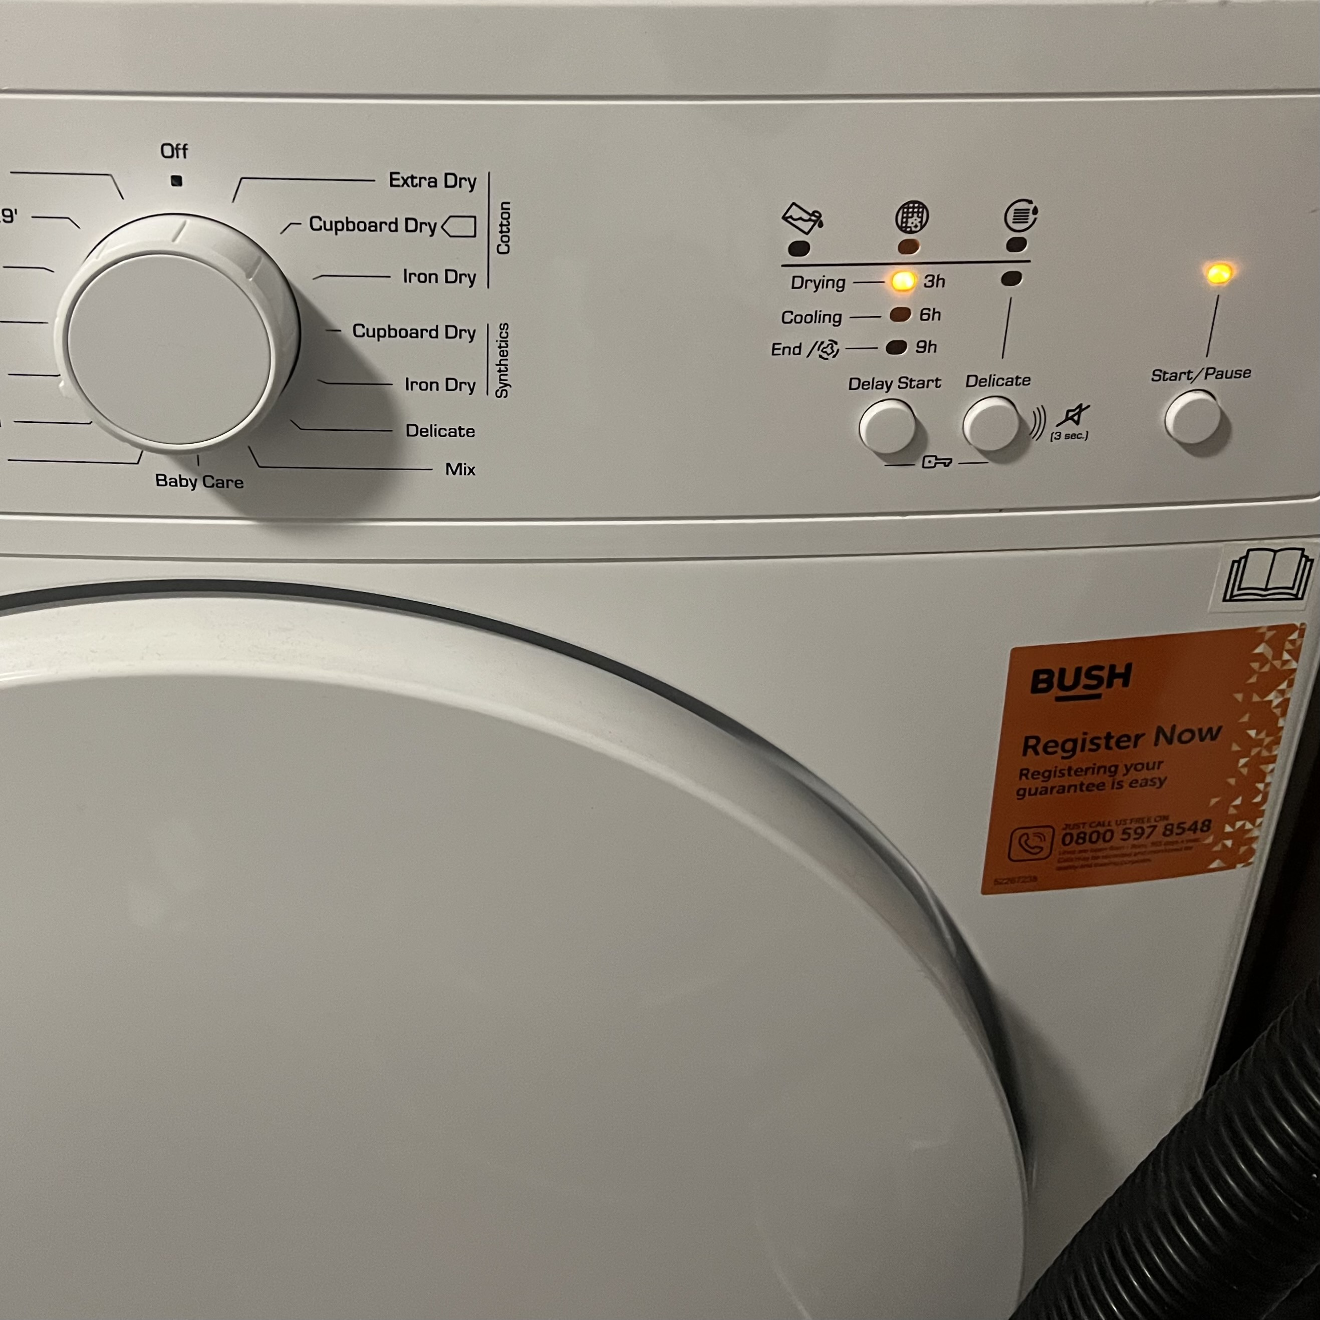
Example of Good and Bad Design
Dryer 1(Good Design) | Dryer 2(Bad Design)
Digital timer that shows exact time remaining | Only indicator lights, no countdown. Users unable to know time left.
Multiple drying levels and time options | Limited preset modes

Slide 20
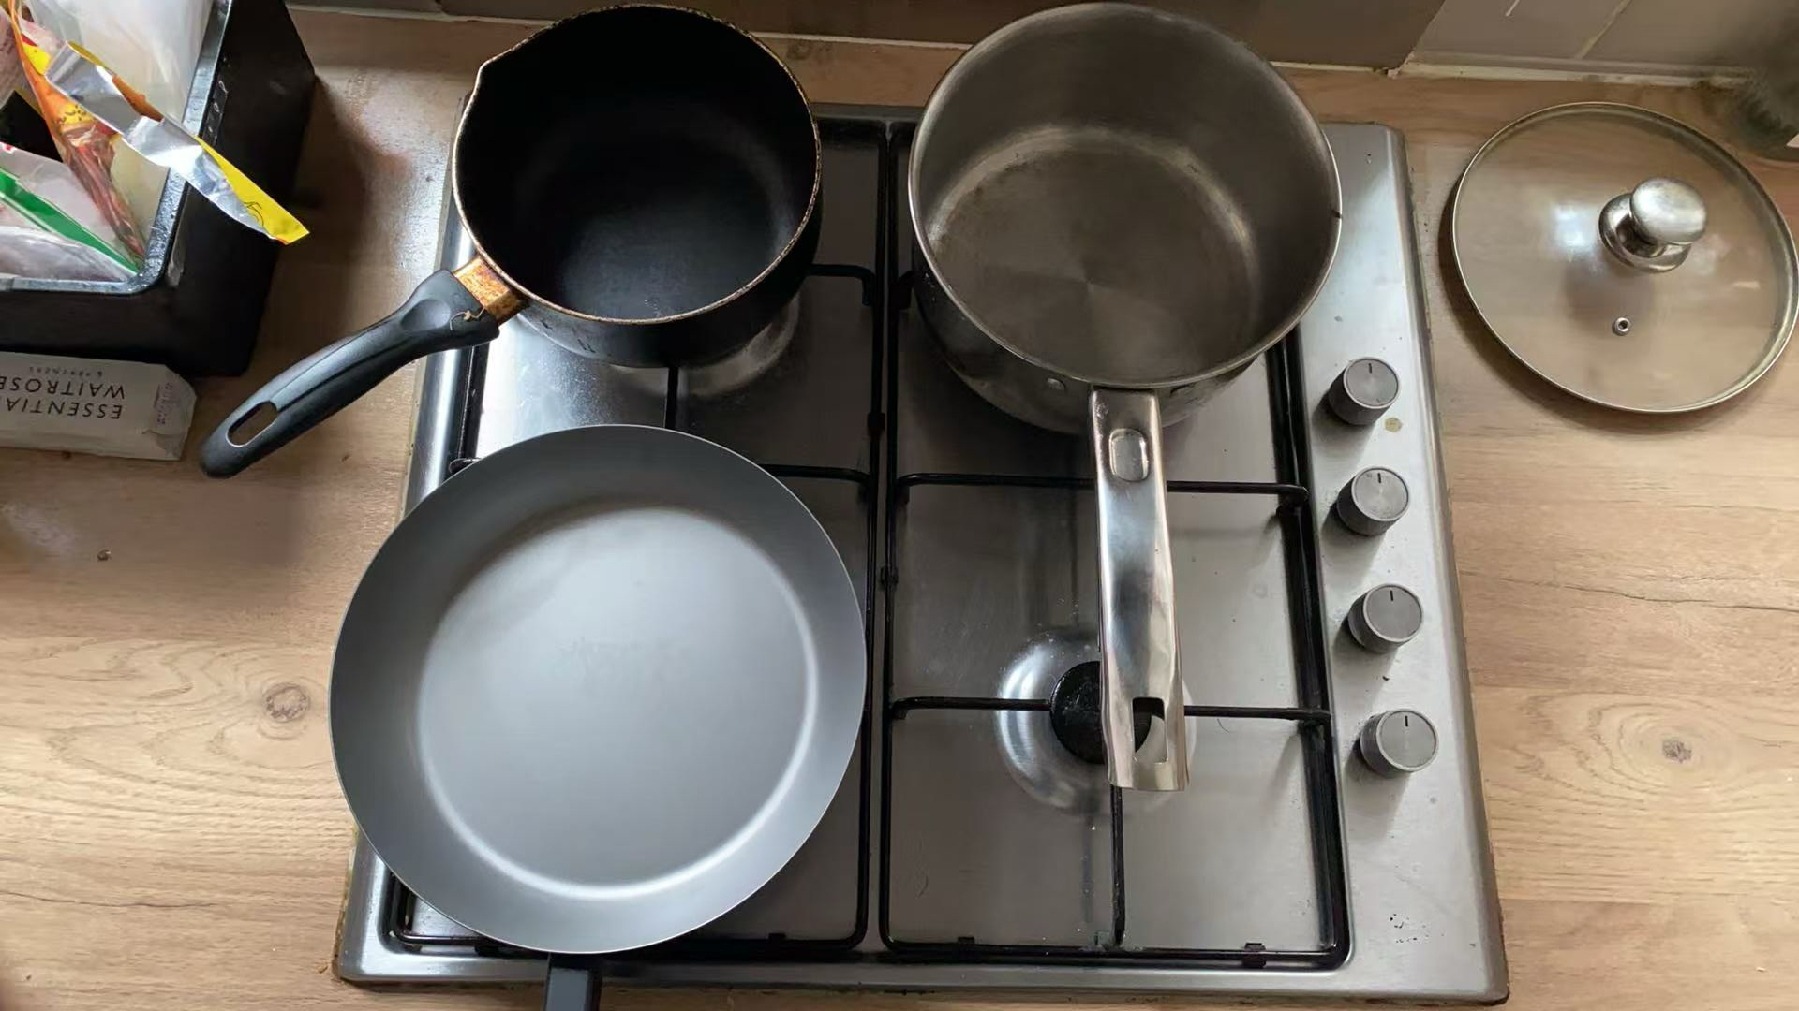
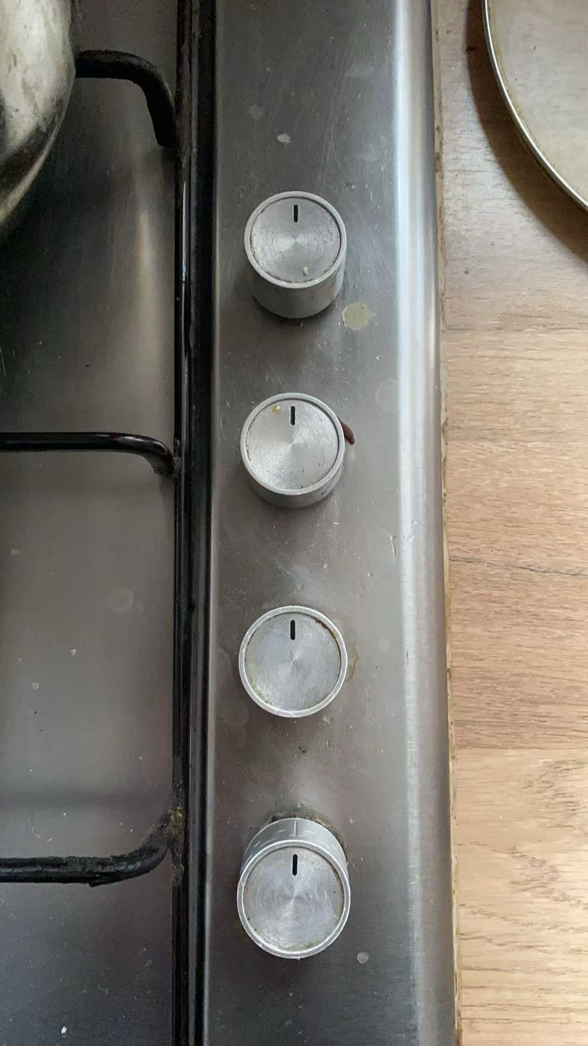
Bad Design of Cooktop & Control Knob
User’s Perspective Photo
Detail of Knob
Problems with the gas stove design:
1. Unsafe knob placement
All four control knobs are positioned on the right-hand side. During cooking, I have to reach across to the right in order to adjust the flame. If a pot is already in use, this forces me to extend my arm over a hot surface, where splattering oil could easily burn my hand. Alternatively, I need to move to the right before making adjustments, which reduces efficiency and increases the risk of accidents.
2.Lack of burner–knob mapping
There is no clear indication of which knob control which burner. Each time I need to try them one by one until I find the correct one, and only then can I place a pot on it. This creates unnecessary trial-and-error and delays the cooking process.
3.Poor flame visibility
From the user’s eye-level perspective, it is difficult to confirm the flame size when adjusting the knobs. I often need to bend down or lean over in order to check whether the flame matches my intended level, which interrupts the workflow and causes discomfort.
Suggested improvements:
1.Redesign knob layout
Move the control knobs to the front panel and arrange them in a square configuration that reflects the spatial position of the burners, rather than in a straight line. This would improve intuitiveness and reduce unsafe hand movements.
2.Provide clear feedback
Add flame-size indicators or intuitive icons around each knob. Alternatively, integrate a small reflective surface near each burner so users can see the flame size without leaning forward. This would enhance situational awareness and provide immediate feedback for successful operation.

Slide 21
Human Information Processing (Wickens, 1998)
Attention resources
Short-term sensory store
Perception
Response selection
Response execution
Thought,
Decision making
Stimuli
Response
Working memory
Long-term memory
Memory
Feedback
Notes:
Wickens: a framework for interacting with systems and for task analysis
Each block is a processing stage (or mental operation) that typically occur in the flow of information.
Stimuli are processed by senses then held in STSS
More than 5 senses? (Sense of balance/equilibrioception; proprioception (knowing which parts of your body are where); kinaesthesia (sense of movement); thermoception (sense of heat); nocioception (ability to feel pain); chronoception (sense of passing time).
Perception: the meaning of the signal (derived from past experience – from LTM)
From wickens:
Consider as an example the task of driving toward an intersection. As shown on the left of Figure 1.1, events in the environment are first processed by our senses —sight, sound, touch, etc.—and may be held briefly in short term sensory store (STSS ) for no more than about a second. Thus the driver approaching the intersection will see the traffic light, the flow of the environment past the vehicle, and other cars, and may hear the radio and the conversation of a passenger. But sensation is not perception, and of this large array of sensory information only a smaller amount may be actually perceived ( e.g., perceiving that the light has turned yellow). Perception involves determining the meaning of the sensory signal or event, and such meaning is, in turn, derived from past experience (a yellow light means caution). As we see below, this past experience is stored in our long term memory of facts, images, and understanding of how the world works. Wickens, Christopher D., et al. Engineering Psychology and Human Performance, Taylor & Francis Group, 2012. ProQuest Ebook Central, http://ebookcentral.proquest.com/lib/nottingham/detail.action?docID=3570443. Created from nottingham on 2023-08-29 12:57:34.
After perception, our information processing typically follows either (or both) of two paths. At the bottom, perceiving (understanding) a situation will often trigger an immediate response, chosen or selected from a broader array of possibilities. Here the driver may choose to depress the accelerator or apply the brake, a decision based on a variety of factors, but one that must be made rapidly. Then, following response selection , the response is executed in stage 4 of our sequence in a manner that not only involves the muscles, but also the brain control of those muscles. Wickens, Christopher D., et al. Engineering Psychology and Human Performance, Taylor & Francis Group, 2012. ProQuest Ebook Central, http://ebookcentral.proquest.com/lib/nottingham/detail.action?docID=3570443. Created from nottingham on 2023-08-29 12:58:02.
Thereafter, can either make response selection (e.g. slam on brake), or think about it. Could be held temporarily in working memory, or rehearsed and committed to LTM.
But perception and situation understanding do not always trigger an immediate response. Following the upper path from perception, the driver may use working memory to temporarily retain the state of the light (yellow), while scanning the highway and the crossing road ahead for additional information (e.g., an approaching vehicle or a possible police car). In fact, in many cases an overt action does not follow perception at all. As you sit in lecture you may hear an interesting fact from the lecturer, but choose not to take notes on it (no response selection and execution), but rather to ponder it, rehearse it, and learn it. That is, to use working memory to commit the information to long term memory, for future use on an exam or in applications outside of the classroom. Thus, the function of working memory is not just to store information, but also to think about it: the process of cognition . At this point we note that the processes of perception and working memory are not as distinct from each other as the separate boxes would suggest. There is a fuzzy boundary between them, and hence this second stage— after sensation, but before response selection— can often be described as “cognition,” generically describing the interpretation of sensed material , sometimes rapidly as the traffic light and sometimes more slowly as the idea presented by the lecturer. To this four-stage + memory model, we add two vital elements, feedback and attention . First, in many (but not all) information processing tasks, an executed response changes the environment, and hence creates a new and different pattern of information to be sensed, as shown by the feedback loop at the bottom. Thus, if the driver applies the accelerator, this will not only increase the perceived speed of the car, but also may reveal new sensory information (e.g., a police car is suddenly revealed waiting behind a sign), which in turn may require a revision of the stop-go response choice. Wickens, Christopher D., et al. Engineering Psychology and Human Performance, Taylor & Francis Group, 2012. ProQuest Ebook Central, http://ebookcentral.proquest.com/lib/nottingham/detail.action?docID=3570443. Created from nottingham on 2023-08-29 12:58:47.
Second, attention is a vital tool for much of information processing, and here it plays two qualitatively different roles (Wickens & McCarley, 2008). In its first role as a filter of information that is sensed and perceived, attention selects certain elements for further processing, but blocks others, as represented in Figure 1.1 by the smaller output from perception than input to it. Thus, the driver may focus attention fully on the traffic light, but “tune out” the conversation of the passenger or fail to see the policeman. In the second role attention acts as a fuel that provides mental resources or energy to the various stages of information processing, as indicated by the dashed lines flowing from the supply of resources at the top. Some stages demand more resources in some tasks than others. For example, peering at the traffic light through a fog will require more effort for perception than seeing it on a clear, dark night. However, our supply of attentional resources is limited, and hence the collective resources required for one task may not allow enough for a concurrent one, creating a failure in multi-tasking. Wickens, Christopher D., et al. Engineering Psychology and Human Performance, Taylor & Francis Group, 2012. ProQuest Ebook Central, http://ebookcentral.proquest.com/lib/nottingham/detail.action?docID=3570443. Created from nottingham on 2023-08-29 12:59:07.
The stages in middle – thinking – cognition
Attention – two roles – as a filter, but also as a resource.
Don’t take too literally. Can’t see the “response selection” box in someone’s head.
Will go into further detail on perception and memory today – will do attention and decision making in other lectures.

Slide 22

Multimodal perception – interference between senses
Youtube video from BBC exploring visual interference with sound perception
Image courtesy of BBC, taken from: https://www.youtube.com/watch?v=G-lN8vWm3m0&t=90s

Slide 23
Memory – memory stores
Multi-Store Model of Memory (Atkinson & Shiffrin, 1968)
Sensory Stores
Attention
Short-term store
Rehearsal
Long-term store
Decay
Displacement
Interference
Notes:
Will go through a brief history of memory theories – some of the phenomenon are still relevant.
Multi-store models are traditionally favoured by people studying memory. Intuitively makes sense…but recently there are unifying theories.
This is an early multi-store model.
Sensory stores are modality specific. Info is held briefly…if attended it’s processed further by the short-term store.
Q. Why don’t we just process everything?
With rehearsal, memories committed to LTM.
Attention and memory are strongly related.

Slide 24
Memory stores (Atkinson & Shiffrin)
Sensory stores, holds information very briefly ​ modality-specific​
Iconic (visual – stimulus delay occurs within ~0.5 sec)​
Echoic (auditory – stimulus delay occurs within ~2 sec)​
Short-term store​
Transferred information previously held in sensory store which has been attended to​
Very limited capacity​
Susceptible to loss of information due to distraction​
Long-term store​
Information “rehearsed” in Short term store transferred​
Potentially “unlimited” capacity​
Can hold information over extremely long periods of time

Slide 25

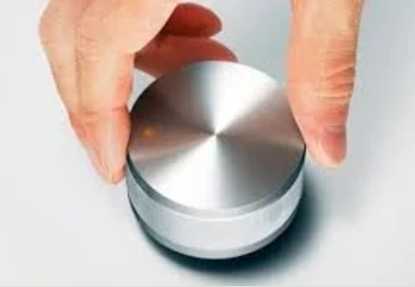
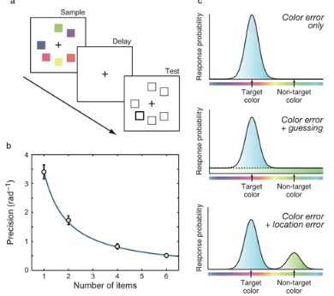
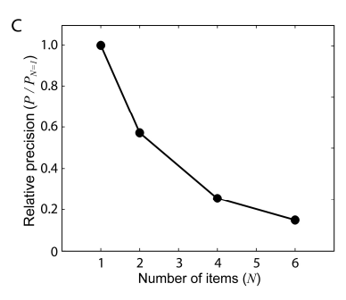
Short-term memory capacity
Magic Number “seven, plus or minus two”​
“Chunks” of information (Miller, 1956)​
Simon (1974) – number of chunks in span is less with larger chunks than with smaller chunks​
BUT – possible interference in experimental data from LTM; Cowan 2000 argues that it drops to 4 chunks when rehearsal eliminated.
Husain (various, e.g. Bays and Husain 2008) argues that memory has an analogue precision; more precision, less items
Notes:
Intereference – Cowan, 2000 argued that when rehearsal and LTM are eliminated (e.g. presenting cues rapidly to avoid rehearsal), capacity of STM is only about 4 chunks.

Slide 26
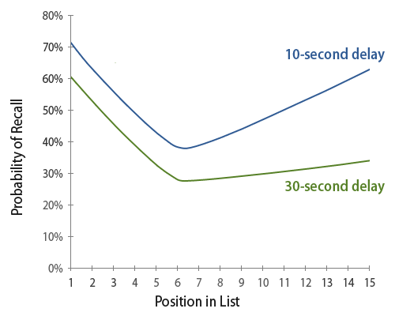
Primacy and recency effects
http://assets.baymard.com/blog/serial-position-effect.png
Notes:
Murdock, 1962 identified primacy and recency effects- you can recall items at start and end of a list better than those in the middle. Theorised to be due to LTM – primacy – rehearsal – and STM –recency – recall.
With a delay (during which participants have a distractor task, e.g. counting backwards), the recency effect is reduced.
What’s the implications:
- Put least important items in the middle of a list
- put most important items at the start of a list…e.g. list your product’s main benefits first
- Beware of list characteristics if designing a survey

Slide 27
Criticisms of Modal Model
Over simplified
Evidence that short term store may behave differently for different senses
Fail to explain how information stored in Long term store, rehearsal not always needed
Concentration on structure of memory rather than process involved in memory and learning
Vague and poorly understood neural mechanisms
Notes:
Evidence that short term store may behave differently for different senses – as we’ll see with Baddeley and Hitch, 1974 model – working memory with three different components; there are also several LTM systems.
Fail to explain how information stored in Long term store – for example, it relies on rehearsal, whereas subconscious LTM exists; the role of rehearsal in our every day lives is actually very limited.

Slide 28
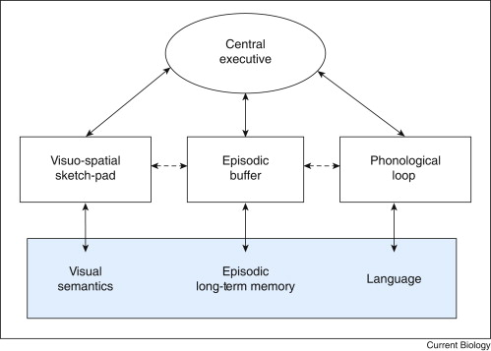
Memory – working memory
Image source: Baddeley, A., 2010. Working memory. Current biology, 20(4), pp.R136-R140.
Notes:
Baddeley & Hitch (1974)
Replace concept of STM with “working memory”
3 (now 4) Components of working memory
A modality-free central executive resembling attention – assigns attentional resources to other systems & resists distractions.
An articulatory or phonological loop, which holds information in a phonological (i.e. speech-based) form
A visuo-spatial scratch pad (now known as sketch pad) which is specialised for spatial and/or visual coding – holds information in an analog, spatial form.
The episodic buffer – used to retain memories of units of visual, spatial, and verbal information and chronological ordering (e.g., the memory of a story or a movie scene)
Working memory decreases with age.

Slide 29

Implications for design
Limit demands on working memory
Consider whether users need to remember information or not for effective operation
Don Norman “Knowledge in the Head” vs “Knowledge in the World” (Don Norman, Design of Everyday Things, Chap 3)
“Putting your password in the world is the antithesis of security; nevertheless, according to this PEW report, against all security rational, 49% of American users write down their passwords to keep track of them.”

Slide 30
Implications for design – part 2
Does anyone know the most used password in 2023?
123456
password
123456789
12345
12345678
qwerty
1234567
111111
1234567890
123123
People are “cognitive misers” (spend thrifts) – we avoid exerting cognitive effort.
How might you overcome this issue when setting passwords?
Source: 20 Most Hacked Passwords in 2023: Is Yours Here? (safetydetectives.com)
Notes:
“force” use of special characters – okay, but people don’t like being forced
Password management tools are probably a better option
Multifactor authentication
biometrics

Slide 31
Microbreak
Does anyone have an interesting anecdote about a memory failure they’d like to share???????
Notes:
Forgetting my pin – I had been stressed and there is evidence that cortisol can affect memory recall.

Slide 32
Long term memory – different types
Declarative memory (sometimes called explicit)
Semantic memory
Structured record of facts, meanings, concept and knowledge
Can be consciously recalled
Independent of personal experience and spatial/temporal context
“The module code is MMME4054”
Episodic memory
Memory of experiences and specific events
Semantic memory can be derived from episodic memory E.g. Using a story to underpin a fact to improve its memorability
“In the first lecture, Kyle showed a silly video about Norman doors”
Procedural memory (part of implicit long term memory)
Unconscious memory of skills and how to do things
Aids ‘automatic’ behaviour
I know how to write, ride a bike, touchtype, etc

Slide 33
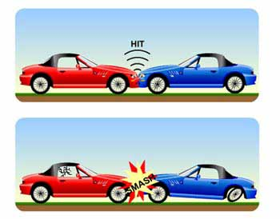
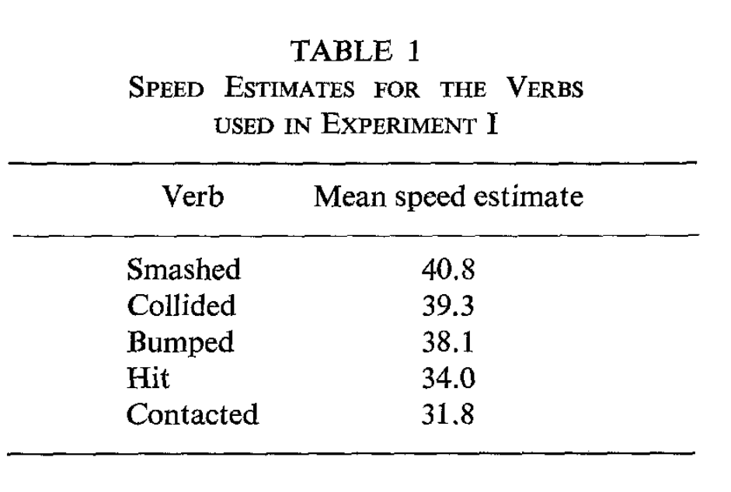
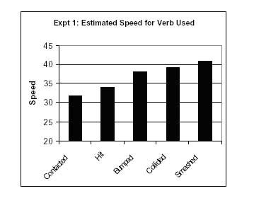
Eyewitness Testimony and Flashbulb memory
Eyewitness: Loftus et al (1979 onwards)
If witness exposed to new post-event information this may affect recall of events
Witness memory can be altered by type of questions posed during questioning
Ted talk on False memories and behaviour change
Flashbulb (Brown & Kulik, 1982 and others)
Vivid memory of dramatic or surprising event
May be preserved due to trigger of neural mechanism due to surprise, consequentiality etc.
May be maintained by repeated reporting of incident
Memories may still change or decay over time
Taken from: Loftus, E.F. and Palmer, J.C., 1974. Reconstruction of automobile destruction: An example of the interaction between language and memory. Journal of verbal learning and verbal behavior, 13(5), pp.585-589.
Notes:
Loftus and Palmer | Simply Psychology:
Experiment One
Procedure: Forty-five American students from the University of Washington formed an opportunity sample. This was a laboratory experiment with five conditions, only one of which was experienced by each participant (an independent measures experimental design).
7 films of traffic accidents, ranging in duration from 5 to 30 seconds, were presented in a random order to each group.
After watching the film participants were asked to describe what had happened as if they were eyewitnesses. They were then asked specific questions, including the question “About how fast were the cars going when they (smashed / collided / bumped / hit / contacted) each other?”
Thus, the IV was the wording of the question and the DV was the speed reported by the participants.
Findings: The estimated speed was affected by the verb used. The verb implied information about the speed, which systematically affected the participants’ memory of the accident.
Participants who were asked the “smashed” question thought the cars were going faster than those who were asked the “hit” question. The participants in the “smashed” condition reported the highest speed estimate (40.8 mph), followed by “collided” (39.3 mph), “bumped” (38.1 mph), “hit” (34 mph), and “contacted” (31.8 mph) in descending order.
Conclusion: The results show that the verb conveyed an impression of the speed the car was traveling and this altered the participants' perceptions. In other words, eyewitness testimony might be biased by the way questions are asked after a crime is committed. Loftus and Palmer offer two possible explanations for this result:
Response-bias factors: The misleading information provided may have simply influenced the answer a person gave (a 'response-bias') but didn't actually lead to a false memory of the event. For example, the different speed estimates occur because the critical word (e.g. 'smash' or 'hit') influences or biases a person's response.
The memory representation is altered: The critical verb changes a person's perception of the accident - some critical words would lead someone to have a perception of the accident being more serious. This perception is then stored in a person's memory of the event.
If the second explanation is true we would expect participants to remember other details that are not true. Loftus and Palmer tested this in their second experiment.

Slide 34

Memory during traumatic events
“How does emotion in a traumatic event like 9/11 influence our memories?
Emotion kind of focuses you on a few details but lets you ignore other details. And if you are highly aroused by fear, that emotion helps you store things in your memory better, in a storage process called consolidation that depends on the interaction of the amygdala and hippocampus. But what we've known for a while is that emotion gives you a stronger confidence in your memory than it does necessarily in the accuracy.”
Interview with NYU psychologist and 911 researcher Elizabeth A. Phelps, taken from Scientific American
By UA_Flight_175_hits_WTC_south_tower_9-11.jpeg: Flickr user TheMachineStops (Robert J. Fisch)derivative work: upstateNYer - UA_Flight_175_hits_WTC_south_tower_9-11.jpeg, CC BY-SA 2.0, https://commons.wikimedia.org/w/index.php?curid=11786300
Notes:
“Everyone thinks, "Oh, I never would forget that." But we know from a lot of studies from the past 30 years that people aren't necessarily right. You can't even convince people that their memories are wrong. All you can say is that data would suggest your memory's wrong.
With emotional events like 9/11, I think we do have better memory for the important details [as compared with a neutral event]—we just don't have great memory for all the details. And we think we do, and that's the real contrast. Whereas, if I told you that you don't remember the details of your 26th birthday, you wouldn't be surprised, necessarily.
Our measure of accuracy is consistency with what people told us in the survey the week after the attack. From that first survey to the second survey a year later, the overall consistency of the details of how they learned of 9/11 was only 63 percent. At the third survey, three years after the attack, consistency was 57 percent. So people were only a little more than 50 percent right for a lot of the details.
How well did people remember the facts about the attack itself? They were better at memories for the facts of the attack than they were for their personal recollections. For instance, in recalling the number of planes involved, they were 94 percent accurate immediately afterward in the first survey, 86 percent accurate a year later, and 81 percent accurate three years later. But of course, those facts are supported by external reminders from media coverage.

Slide 35

Long term memory
“People only remember enough of the visual properties of objects to be able to make the quite gross discriminations required in everyday life” (Cohen, 1996)
Schema theory (Rumelhart & Ortony, 1977)
Schemata = organized mental structures that aid the learners’ ability to understand and associate what is being presented to them
What is normal, typical, relevant or consistent with pre-existing knowledge will be remembered better than what is unexpected, bizarre or irrelevant (maybe?)
But – also Brewer and Tenpenny (1996) – distinctiveness mechanism i.e. tendency to remember what is bizarre

Slide 36
Prospective memory (Einstein and McDaniel, 1990; Ellis, 1996)
The ability to remember to carry out intended actions in the future
Can be time-based or event-based
Components:
Intention formation
Retention
Cue detection
Execution
Challenges – requires self-monitoring (capacity-consuming)
Can be disrupted by distractions or changes in routing
Plays an important role in planning and managing daily activities
Uses combination of working memory and attention
Notes:
Definition: Prospective memory refers to the ability to remember to carry out intended actions in the future, such as remembering to attend a meeting or take medication at a specific time.
Types:
Time-based prospective memory: Remembering to do something at a particular time (e.g., "I need to call someone at 3 PM").
Event-based prospective memory: Remembering to perform an action when a specific event occurs (e.g., "When I see my colleague, I need to give them the report").
Key Components:
Intention formation: Formulating the intention or goal (e.g., planning to buy groceries after work).
Retention: Keeping the intention in memory during the delay between forming the intention and executing it.
Cue detection: Recognizing the appropriate time or situation (a cue) that triggers the intended action.
Execution: Carrying out the intended action once the cue is detected.
Challenges:
Requires self-monitoring to detect when the cue for the task arises.
Can be disrupted by distractions or changes in routine, especially with time-based tasks.
Cognitive aging and conditions like Alzheimer's disease can impair prospective memory performance.
Importance in daily life: Prospective memory is crucial for planning and managing daily activities, such as appointments, deadlines, and routine tasks.
Real-life examples: Remembering to pick up children from school, mailing a letter when passing a postbox, or turning off the oven after cooking.
Cognitive resources involved: Prospective memory tasks depend on a combination of working memory, executive functions, and attentional processes.
Applications in psychology: Studied in cognitive psychology to understand how people plan, remember intentions, and deal with interruptions in goal-directed behavior.
Improving prospective memory:
External aids: Using reminders like alarms, notes, or apps to help trigger memory.
Implementation intentions: Creating specific action plans that link cues to tasks ("If X happens, then I will do Y").
Criticisms: The PAM (Preparatory Attentional and Memory) theory suggests that prospective memory tasks require continuous maintenance of an intention from formation to execution. However, research by Reese and Cherry (2002) showed that only 2% of participants thought about their intention when interrupted, casting doubt on this theory for routine tasks.
Alternatively, Einstein and McDaniel's reflexive-associative theory (1990) found that intentions often "pop" into mind automatically. This theory proposes that an association is formed between a cue and an action, and when the cue appears, the associative memory system automatically triggers the retrieval of the intended action without needing constant conscious monitoring.

Slide 37
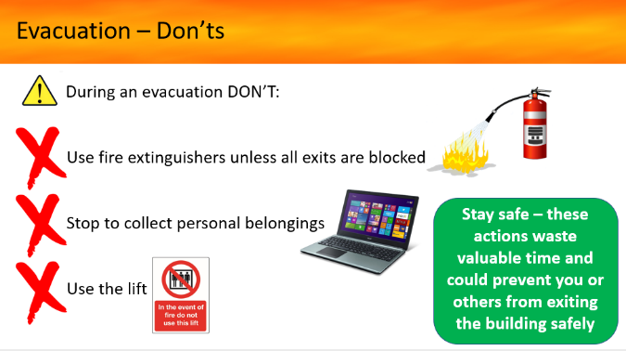
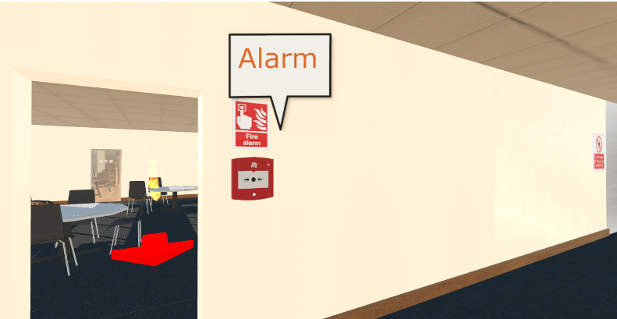
Fire safety training study
PowerPoint training:
retention
uptake
VE training:
Uptake: PPT
Retention: VE
https://iosh.com/multisensoryVE

Slide 38

Memory in the real world – Activity
ACTIVITY!!!!
Step 1: without looking, draw out the apps on your home screen of your phone
Step 2: when finished, look at the actual apps on your home screen
Step 3: think about the implications for memory…do you need to remember the apps? Can you still use your phone?
Recognition vs. recall.
My 2016 Phone Homescreen - Begin the Begin (jeffhilimire.com)

Slide 39
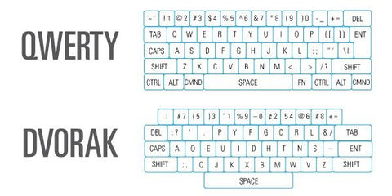
Proactive and Retroactive Interference
Previous and subsequent learning can disrupt and interfere with memories.
Proactive; Old memories interfering with learning new information.
If I already know how to type using a QWERTY keyboard layout, learning DVORAK may be harder because the old memories interfere!
Retroactive; learning new things can make it harder to recall old information.
Say I now start learning DVORAK and am using it for months, I may find it harder to go back to QWERTY
Postman & Underwood (1973). Critical Issues in Interference.
Notes:
Definition: Prospective memory refers to the ability to remember to carry out intended actions in the future, such as remembering to attend a meeting or take medication at a specific time.
Types:
Time-based prospective memory: Remembering to do something at a particular time (e.g., "I need to call someone at 3 PM").
Event-based prospective memory: Remembering to perform an action when a specific event occurs (e.g., "When I see my colleague, I need to give them the report").
Key Components:
Intention formation: Formulating the intention or goal (e.g., planning to buy groceries after work).
Retention: Keeping the intention in memory during the delay between forming the intention and executing it.
Cue detection: Recognizing the appropriate time or situation (a cue) that triggers the intended action.
Execution: Carrying out the intended action once the cue is detected.
Challenges:
Requires self-monitoring to detect when the cue for the task arises.
Can be disrupted by distractions or changes in routine, especially with time-based tasks.
Cognitive aging and conditions like Alzheimer's disease can impair prospective memory performance.
Importance in daily life: Prospective memory is crucial for planning and managing daily activities, such as appointments, deadlines, and routine tasks.
Real-life examples: Remembering to pick up children from school, mailing a letter when passing a postbox, or turning off the oven after cooking.
Cognitive resources involved: Prospective memory tasks depend on a combination of working memory, executive functions, and attentional processes.
Applications in psychology: Studied in cognitive psychology to understand how people plan, remember intentions, and deal with interruptions in goal-directed behavior.
Improving prospective memory:
External aids: Using reminders like alarms, notes, or apps to help trigger memory.
Implementation intentions: Creating specific action plans that link cues to tasks ("If X happens, then I will do Y").
Criticisms: The PAM (Preparatory Attentional and Memory) theory suggests that prospective memory tasks require continuous maintenance of an intention from formation to execution. However, research by Reese and Cherry (2002) showed that only 2% of participants thought about their intention when interrupted, casting doubt on this theory for routine tasks.
Alternatively, Einstein and McDaniel's reflexive-associative theory (1990) found that intentions often "pop" into mind automatically. This theory proposes that an association is formed between a cue and an action, and when the cue appears, the associative memory system automatically triggers the retrieval of the intended action without needing constant conscious monitoring.

Slide 40
Implications for design - memory
Minimise demand on memory
Put more knowledge “in the world”
Different types of long-term memory
Implication of memory types for design of information during use, and expectations for training​
Using meaning to support transfer into long term memory​
Ensuring rehearsal possible if necessary to transfer to long term memory​
Support transfer to semantic memory by means of episodic information
Could similar processes interfere?

Slide 41
Other Memory Research (for study!)
Effortful recall practice improves recall. After reading a text, one group reread the text several times (crammers), another group took practice tests (testers). One immediate testing the first group did better, but delayed tests of more than a week testers did better.
Roediger & Karpicke (2006)
Effortful recall, “interleaving” (different subjects) and spaced retrieval practice stops memory decay.
Cepeda et al (2006)
Mixing problems together, is harder, and therefore helps later recall
Rohrer (2007)
“Make it Stick”, Brown, Roediger, McDaniel. 2014

Slide 42
Quiz Time

Slide 43
Recap
Human Information Processing Model by Wickens
Memory states (short term, long term)
Working memory with components
Memory capacity 7 +/-2, or is it more analogue?
Primacy and Recency effects
Long-term memory, semantic/declarative, episodic, procedural
Eye-witness testimony
Proactive and retrospective interference
Effortful, interleaved, spaced recall is good for long term learning
Notes:
Definition: Prospective memory refers to the ability to remember to carry out intended actions in the future, such as remembering to attend a meeting or take medication at a specific time.
Types:
Time-based prospective memory: Remembering to do something at a particular time (e.g., "I need to call someone at 3 PM").
Event-based prospective memory: Remembering to perform an action when a specific event occurs (e.g., "When I see my colleague, I need to give them the report").
Key Components:
Intention formation: Formulating the intention or goal (e.g., planning to buy groceries after work).
Retention: Keeping the intention in memory during the delay between forming the intention and executing it.
Cue detection: Recognizing the appropriate time or situation (a cue) that triggers the intended action.
Execution: Carrying out the intended action once the cue is detected.
Challenges:
Requires self-monitoring to detect when the cue for the task arises.
Can be disrupted by distractions or changes in routine, especially with time-based tasks.
Cognitive aging and conditions like Alzheimer's disease can impair prospective memory performance.
Importance in daily life: Prospective memory is crucial for planning and managing daily activities, such as appointments, deadlines, and routine tasks.
Real-life examples: Remembering to pick up children from school, mailing a letter when passing a postbox, or turning off the oven after cooking.
Cognitive resources involved: Prospective memory tasks depend on a combination of working memory, executive functions, and attentional processes.
Applications in psychology: Studied in cognitive psychology to understand how people plan, remember intentions, and deal with interruptions in goal-directed behavior.
Improving prospective memory:
External aids: Using reminders like alarms, notes, or apps to help trigger memory.
Implementation intentions: Creating specific action plans that link cues to tasks ("If X happens, then I will do Y").
Criticisms: The PAM (Preparatory Attentional and Memory) theory suggests that prospective memory tasks require continuous maintenance of an intention from formation to execution. However, research by Reese and Cherry (2002) showed that only 2% of participants thought about their intention when interrupted, casting doubt on this theory for routine tasks.
Alternatively, Einstein and McDaniel's reflexive-associative theory (1990) found that intentions often "pop" into mind automatically. This theory proposes that an association is formed between a cue and an action, and when the cue appears, the associative memory system automatically triggers the retrieval of the intended action without needing constant conscious monitoring.

Slide 44
First coursework…
Deadline is 12th November 2024
Worth 50% of the module marks
1500 words (excluding references, tables). 10% allowance.
Assignment and assessment criteria are available from Moodle
DO NOT plagiarise: Academic integrity and misconduct - The University of Nottingham
You may use AI as a conversational partner to help develop your ideas; but avoid over-reliance. Do not simply paste-in answers (academic misconduct). AI will not be able to construct a high-quality argument at level 4. It must be your work, and you are responsible for everything you submit (mistakes and all).
You must draw from the material in lectures for your coursework (but are also expected to draw from wider literature)
Notes:
Must use data – e.g. primacy/recency, data in support of 7+/-2 (Miller, 1956), the forgetting curve…Ebbinghaus….

Slide 45
Useful resources…
Student academic skills: Moodle: Module: Student Academic Skills: Engineering (UNUK) (nottingham.ac.uk)
Referencing guide: ARU | University Library: ARU Harvard
Searching academic databases: Searching databases - The University of Nottingham

Slide 46
Any questions? Kyle.Harrington@nottingham.ac.uk

